Slide 1
Priority Queues with Binary Heaps

Slide 2
A priority queue acts like a queue in which you dequeue an item by removing it from the front. However, in a priority queue, the logical order of items inside a queue is determined by their priority.
The highest priority items are at the front of the queue and the lowest priority items are at the back. Thus when you enqueue an item on a priority queue, the new item may move all the way to the front.

Slide 3
However, inserting into a list is O(n) and sorting a list is O(nlogn). We can do better. The classic way to implement a priority queue is using a data structure called a binary heap. A binary heap will allow us both enqueue and dequeue items in O(logn).

Slide 4
Binary Heap Tree/Heap Sort

Slide 5
Binary Heap Tree/Heap Tree
A complete binary tree is a binary tree in which every level, except possibly the last, is completely filled, and all the nodes in the last level must be left alligned.
A Binary Heap is a Complete Binary Tree where items are stored in a special order such that value in a parent node is greater(or smaller) than the values in its two children nodes. The former is called as max heap and the latter is called min heap. The heap can be represented by binary tree or array.

Slide 6
Heap Data Structure
A Heap is a special Tree-based data structure in which the tree is a complete binary tree. Generally, Heaps can be of two types:
Max-Heap: In a Max-Heap the key present at the root node must be greatest among the keys present at all of it’s children. The same property must be recursively true for all sub-trees in that Binary Tree.
Min-Heap: In a Min-Heap the key present at the root node must be minimum among the keys present at all of it’s children. The same property must be recursively true for all sub-trees in that Binary Tree.

Slide 7
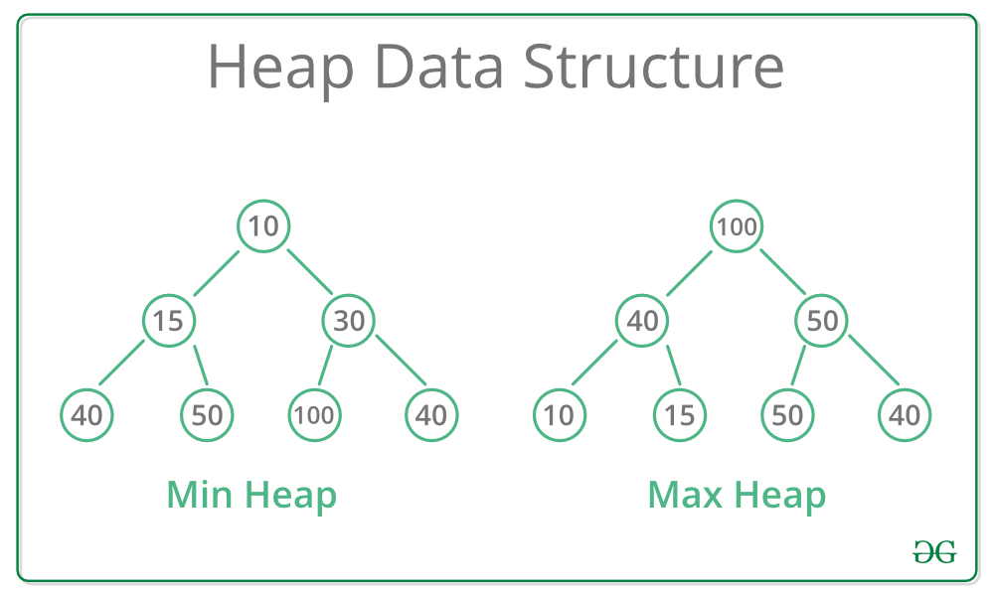
Heap Data Structure

Slide 8
Heap Sort
Heap sort is a comparison based sorting technique based on Binary Heap data structure. It is similar to selection sort where we first find the maximum element and place the maximum element at the end. We repeat the same process for remaining element.

Slide 9
Array Implementation for Binary Heap
Since a Binary Heap is a Complete Binary Tree, it can be easily represented as array and array based representation is space efficient. If the parent node is stored at index I, the index of left child can be calculated by 2 * I + 1 and right child by 2 * I + 2.

Slide 10
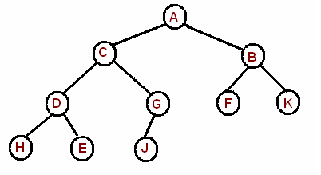
0 | 1 | 2 | 3 | 4 | 5 | 6 | 7 | 8 | 9
A | C | B | D | G | F | K | H | E | J

Slide 11
Binary Heap Operations
The basic operations we will implement for our binary heap are as follows:
BinaryHeap() creates a new, empty, binary heap.
insert(k) adds a new item to the heap.
findMin() returns the item with the minimum key value, leaving item in the heap.
delMin() returns the item with the minimum key value, removing the item from the heap.
isEmpty() returns true if the heap is empty, false otherwise.
size() returns the number of items in the heap.
buildHeap(list) builds a new heap from a list of keys.

Slide 12
Insertion in a Binary Heap
The new element is initially appended to the end of the heap (as the last element of the array). The heap property is repaired by comparing the added element with its parent and moving the added element up a level (swapping positions with the parent). This process is called "percolation up". The comparison is repeated until the parent is larger than or equal to the percolating element.

Slide 13
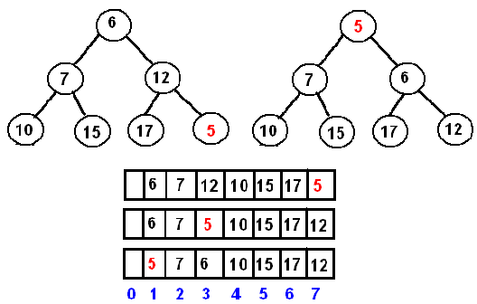
The worst-case runtime of the algorithm is O(log n), since we need at most one swap on each level of a heap on the path from the inserted node to the root.

Slide 14
DeleteMin in a Binary Heap
The minimum element can be found at the root, which is the first element of the array. We remove the root and replace it with the last element of the heap and then restore the heap property by percolating down. Similar to insertion, the worst-case runtime is O(log n).

Slide 15
Heap Sort
The algorithm runs in two steps.
Given an array of data, first, we build a heap and then turn it into a sorted list by calling deleteMin. The running time of the algorithm is O(n log n).
Example. Given an array {3, 1, 6, 5, 2, 4}. We will sort it with the HeapSort.

Slide 16
build a heap 1, 2, 4, 5, 3, 6
turn this heap into a sorted list
deleteMin
1, 2, 4, 5, 3, 6 swap 1 and 6
6, 2, 4, 5, 3 1 restore heap
2, 6, 4, 5, 3 1
2, 3, 4, 5, 6 1
deleteMin
2, 3, 4, 5, 6 1 swap 2 and 6
6, 3, 4, 5 1, 2 restore heap
3, 6, 4, 5 1, 2
3, 5, 4, 6 1, 2
deleteMin
3, 5, 4, 6 1, 2 swap 3 and 6
6, 5, 4 1, 2, 3 restore heap
4, 5, 6 1, 2, 3 restore heap
deleteMin
4, 5, 6 1 2, 3 swap 4 and 6
6, 5 1, 2, 3, 4 restore heap
5, 6 1, 2, 3, 4
deleteMin
1, 2, 3, 4, 5, 6

Slide 17
Applications of Heap
1) Heap Sort: Heap Sort uses Binary Heap to sort an array in O(nLogn) time.
2) Priority Queue: Priority queues can be efficiently implemented using Binary Heap because it supports insert(), delete() and extractmax() operations in O(logn) time.
3) Graph Algorithms: The priority queues are especially used in Graph Algorithms like Dijkstra’s Shortest Path and Prim’s Minimum Spanning Tree.

Slide 18
Why Binary Heap Preferred for Priority Queue?
A typical Priority Queue requires following operations to be efficiently implemented.
Get Top Priority Element (Get minimum or maximum)
Insert an element
Remove top priority element
When we implemented a priority queue with an array or a linked list, the efficiency of some operations were O(n).

Slide 19
Why Binary Heap Preferred for Priority Queue?
 | insert | deleteMin | findMin
ordered array | O(n) | O(n) | O(1)
ordered list | O(n) | O(n) | O(1)
unordered array | O(1) | O(1) | O(n)
unordered list | O(1) | O(1) | O(n)
Using a binary heap, the runtime of both the deleteMin and insert operations is O(log n).
 | insert | deleteMin | findMin
binary heap | O(log n) | O(log n) | O(1)

